Slide 1

Welcome to The Superhero!

Slide 2
Instructor’s Info
Dr. Sylvia Terzian
Email: sterzian@uwaterloo.ca
Office hours: Mondays, 5:00pm – 6:00pm (and by appointment)
Office location: SH 2044

Slide 3

Evening contemplation
Why read or study comics?

Slide 4
Agenda: Monday May 1
Course Orientation; Syllabus
In-class Activity
What is/makes a hero?
Joseph Campbell, Hero’s Journey

Slide 5
In-class activity
Each table is now a group: call yourselves something heroic
Each table must discuss and answer the question provided by the instructor
Each table must introduce themselves to the class and present their reflections to the class

Slide 6


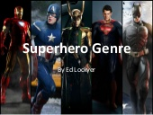
This class is about 3 things:

Slide 7
What makes a Hero?
Act of bravery
Overcome adversity
Persist in the face of fear
Strong moral compass (moral code)
Empathic
Nurturing
Selfless
People of action
“nobility of purpose”

Slide 8
Friedrich Nietzsche puts it best:
To wrench the human soul from its moorings, to immerse it in terrors, ice, flames, and raptures to such an extent that it is liberated from all petty displeasure, gloom, and depression as by a flash of lightening: what paths lead to this goal? And which of them do so most surely?
From The Superhero Reader (On the Geneology of Morals, 1967 [1887]: 139)

Slide 9
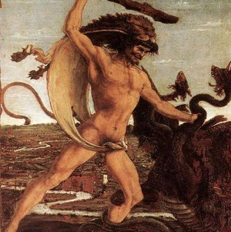
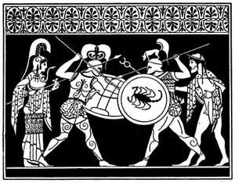
Heroic Models: 1. Greek Myth (demi-god)
Hercules / Herakles
Achilles

Slide 10
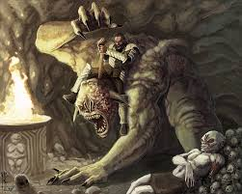
2. Warrior hero /epic hero (divine and mortal)

Slide 11
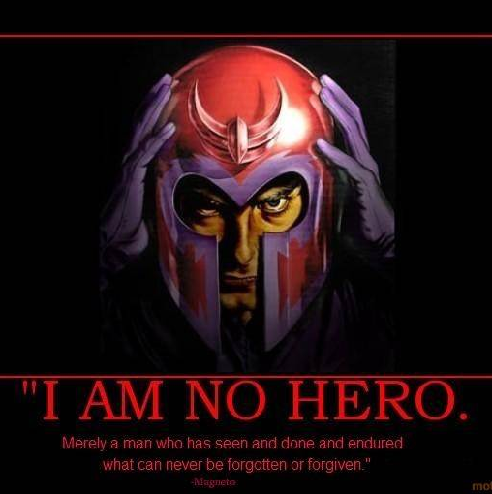

3. Anti-hero (questionable morality)
Magneto
V for Vendetta

Slide 12
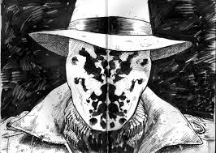
Anti-hero

Slide 13
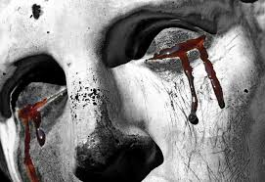
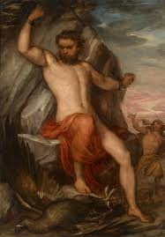
4. Tragic Hero (fallen gods)
Oedipus the King
Prometheus

Slide 14

Tragic Hero: The Myth of Frankenstein

Slide 15
Defining a Hero (OED Online)
1. A name given (as in Homer) to men of superhuman strength, courage, or ability, favored by the gods; at a later time regarded as intermediate between god and men, and immortal.
2. A man distinguished by extraordinary valour and martial achievements; one who does brave or noble deeds; an illustrious warrior.
3. A man who exhibits extraordinary bravery, firmness, fortitude, or greatness of soul, in any course of action, or in connection with any pursuit, work, or enterprise; a man admired and venerated for his achievements and noble qualities.

Slide 16
Defining a Human
1a. Of the nature of the human race; that is a human, or consists of human beings; belonging to the species Homo sapiens or other (extinct) species of the genus Homo.
1b. Chiefly fig. Designating a person who takes on the appearance or form, or who performs the function of a specified (esp. inanimate) thing; (also) designating a person who assumes the appearance, role, or abilities of a specified creature.

Slide 17
Defining a Human
2. Of, relating to, or characteristic of humans as distinguished from God or gods; secular, not divine; (also) of or relating to the abilities or sphere of activity of human as opposed to supernatural beings; mundane, worldly; imperfect, fallible.

Slide 18
Defining a Human
3. Of, relating to, or distinctive of people as distinguished from other animals; of, relating to, or characteristic of the species Homo sapiens or other (extinct) species of the genus Homo.

Slide 19
Defining a Human
4. Of the nature of, relating to, or concerning human beings and their activities, as contrasted (both positively and negatively) with things commonly regarded as impersonal or mechanical, as machines, systems, processes, etc.

Slide 20
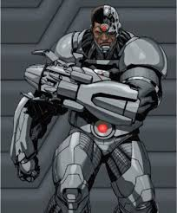
Key Underlying Questions / Concerns
The differences between human and non-human
Cyborg:
Superhero of the modern Age?

Slide 21
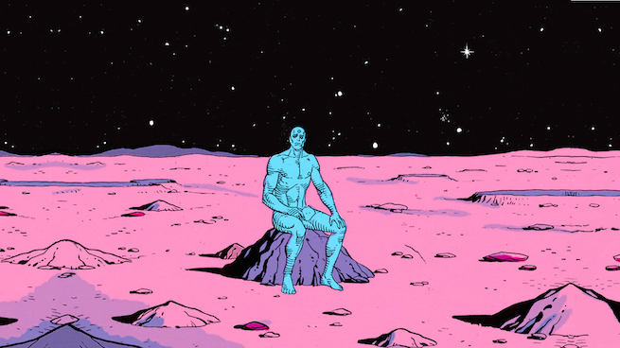
Unbeatable Bad Guy?

Slide 22
Other questions
How is the superhero set apart from ordinary humanity?
Why have Superheroes stood the test of time?
Do they convey meaningful ideas?

Slide 23
Why should we take them seriously?
Ideological meaningful
Culturally meaningful
Socially meaningful
Artistically/aesthetically meaningful
Historically meaningful

Slide 24
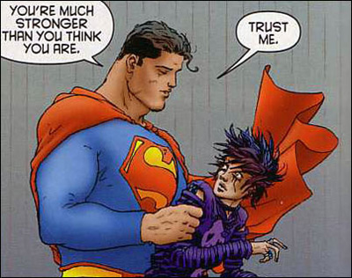
Can we Learn to be Heroes?
Or are we born heroes?
Heroic elect?

